Slide 1
Mini Popper | Colt poppers | Pepper poppers | Plates | Wall feet
7 | 1 | 2 | 0 | 65
Bay | Stage | Type | Count | NS | Total | Hard Cover
A2 | Tantrum | IPSC | 9 | 1 | 10 | 2 Tux 1 Right
A1 | 22-01 | USPSA | 9 | 2 | 11
B1 | F1TTO | IPSC | 3 | 2 | 5 | 1 50%
B2 | Upcycled | USPSA | 12 | 2 | 14
B3 | From the WAC | IPSC | 7 | 1 | 8 | 1 Left Diag 1 50%
B4 | Backpedal | USPSA | 11 | 2 | 13 | 2 Tux 1 Left Diag
Target | Type | Count
IPSC | Tux | 2
IPSC | Left Diag | 1
IPSC | Right Diag | 1
IPSC | 50.00% | 1
IPSC | Lower 1/3 | 1
USPSA | Tux | 2
USPSA | Left Diag | 1

Slide 2
Prop | Stage
Barricade | 3, B1
Swinger | 3, B1
Max trap | 3, B1
Fall forward popper | 3, B1

Slide 3

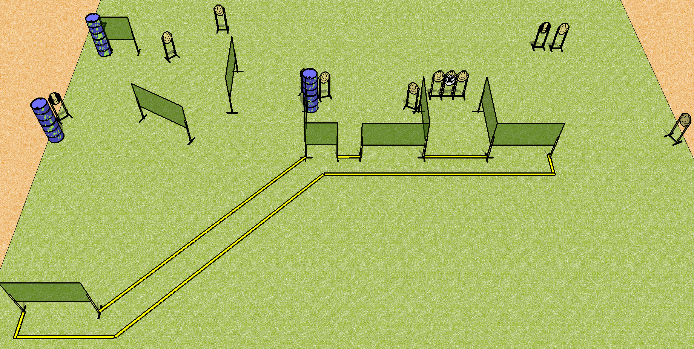
 | Dothan Practical Shooters – USPSA Match Tantrum Course Designer : Drew Coleman Bay: A2
Round Count 25 rounds 12 IPSC 1 mini popper
Equipment List 17 wall feet 2 tux, 1 right diag 10 targets (9 + 1NS)

Slide 4
Tantrum
Written Stage Briefing
Scoring: Comstock Rounds: 25
Targets: 12 IPSC, 1 steel
Handgun start position: anywhere completely outside the shooting area, wrists below belt. Handgun is loaded and holstered.
PCC start position: anywhere completely outside the shooting area, stock on belt. Loaded carbine is held with both hands, safety on.
Stage Procedure: on the audible start signal, engage targets as they become available from within the shooting area.

Slide 5
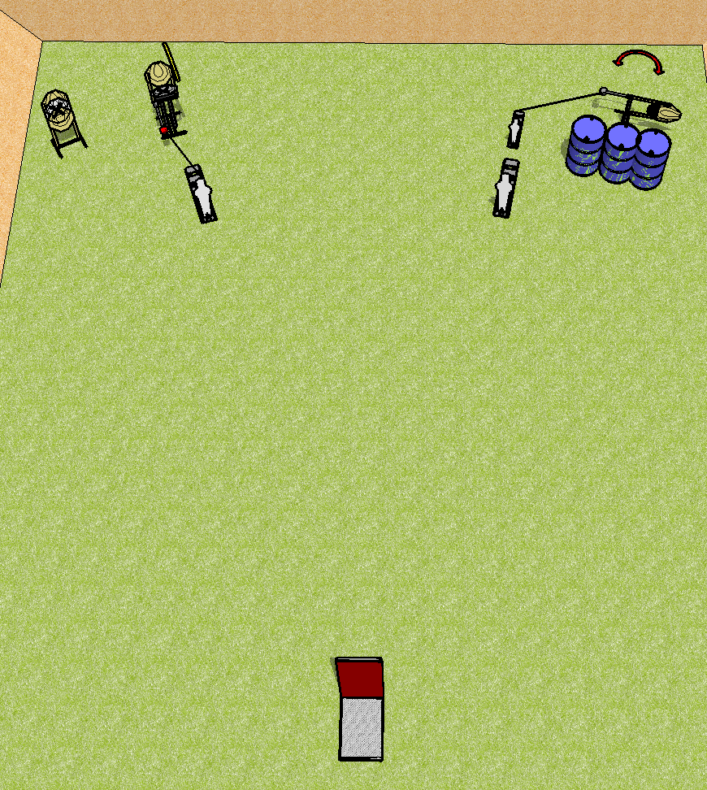
 | Dothan Practical Shooters – USPSA Match First One Then The Other Course Designer : Drew Coleman Bay: B1
Round Count 11 rounds 4 IPSC 2 pepper poppers, 1 mini popper
Equipment List Barricade, max trap, swinger, activators, fall forward popper 1 lower 1/3 hard cover 5 targets (3 + 2 NS)

Slide 6
First One Then The Other
Written Stage Briefing
Scoring: Comstock Rounds: 11
Targets: 4 IPSC, 3 steel
Handgun start position: inside the shooting area, wrists below belt. Handgun is loaded and holstered.
PCC start position: inside the shooting area, stock on belt. Loaded carbine is held with both hands, safety on.
Stage Procedure: on the audible start signal, engage one array, perform a mandatory reload, then engage the other array.
One array is the targets to the left of the barricade (3 IPSC + popper)
The other array is the targets to the right of the barricade (1 IPSC + 2 poppers)
The max trap is activated by P1 and remains visible at rest. The swinger is activated by P3 and also remains visible at rest.

Slide 7
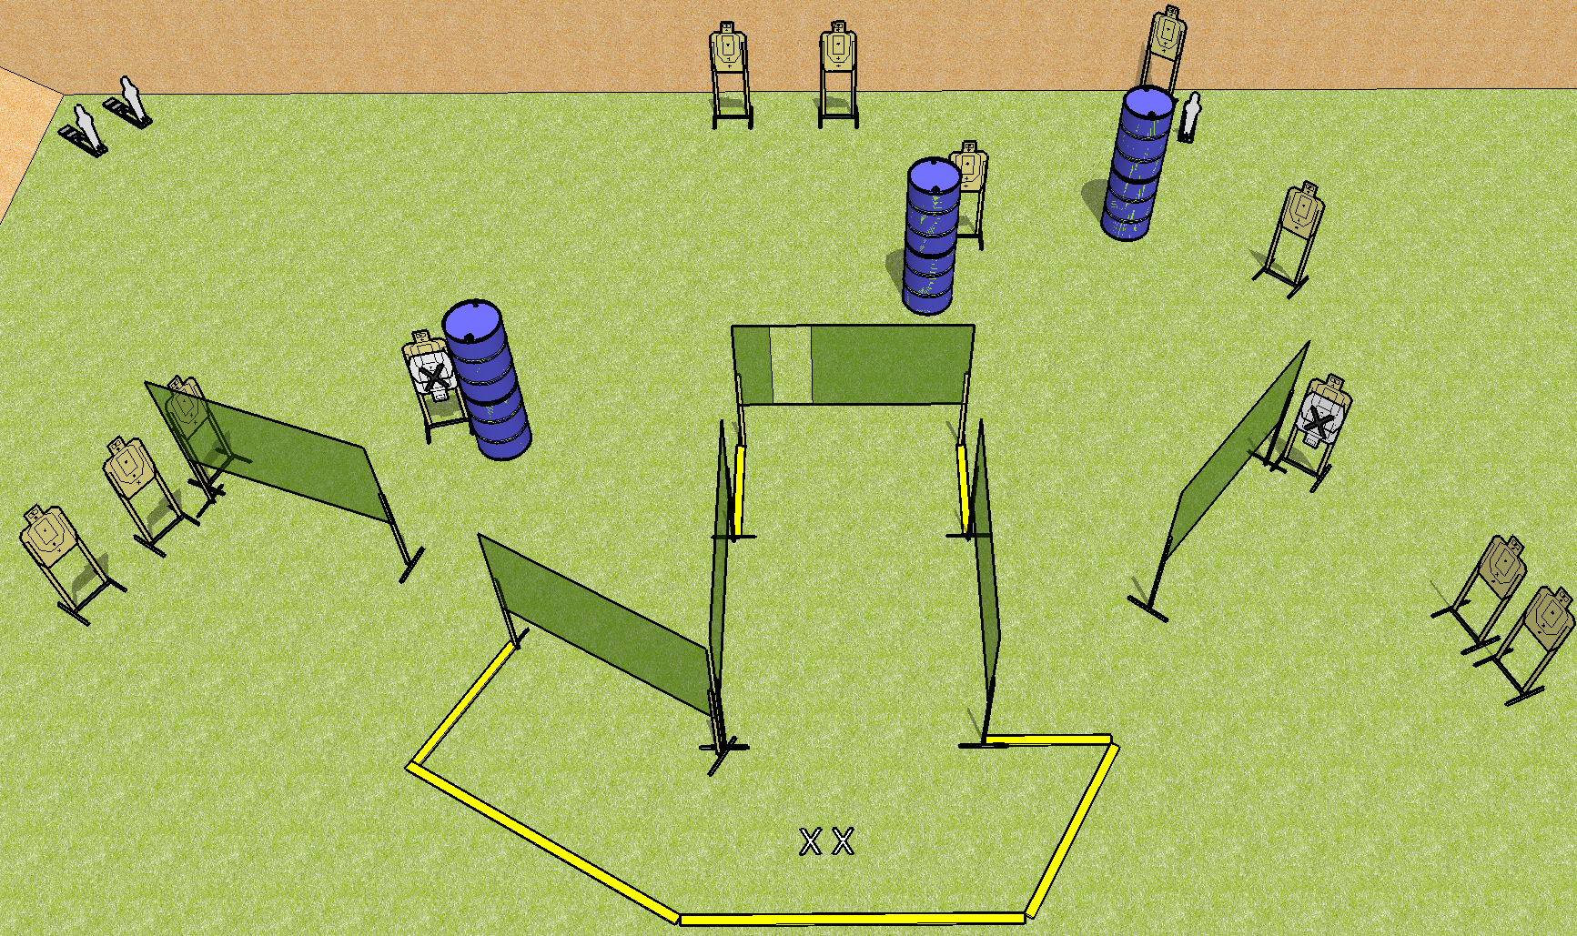
 | Dothan Practical Shooters – USPSA Match Upcycled Course Designer : Drew Coleman Bay: B2
Round Count 27 rounds 12 USPSA 3 mini poppers
Equipment List 12 wall feet 14 targets (12 + 2NS)

Slide 8
Upcycled
Written Stage Briefing
Scoring: Comstock Rounds: 27
Targets: 12 USPSA, 3 steel
Handgun start position: anywhere inside the shooting area, wrists below belt. Handgun is loaded and holstered.
PCC start position: anywhere inside the shooting area, stock on belt. Loaded carbine is held with both hands, safety on.
Stage Procedure: on the audible start signal engage targets as they become available from within the shooting area.

Slide 9
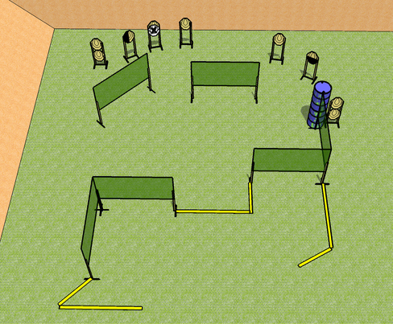
 | Dothan Practical Shooters – USPSA Match From the WAC Course Designer : WAC Design Team Bay: B3
Round Count 18 rounds 9 IPSC
Equipment List 10 wall feet 1 50%, 1 left diag 8 targets (7 + 1NS)

Slide 10
From the WAC
Written Stage Briefing
Scoring: Fixed Time Rounds: 18
Targets: 9 IPSC
Handgun start position: anywhere inside the shooting area, wrists below belt. Handgun is loaded and holstered.
PCC start position: anywhere inside the shooting area, stock on belt. Loaded carbine is held with both hands, safety on.
Stage Procedure: on the audible start signal, engage targets as they become available from within the shooting area.
String time: 8 seconds.

Slide 11
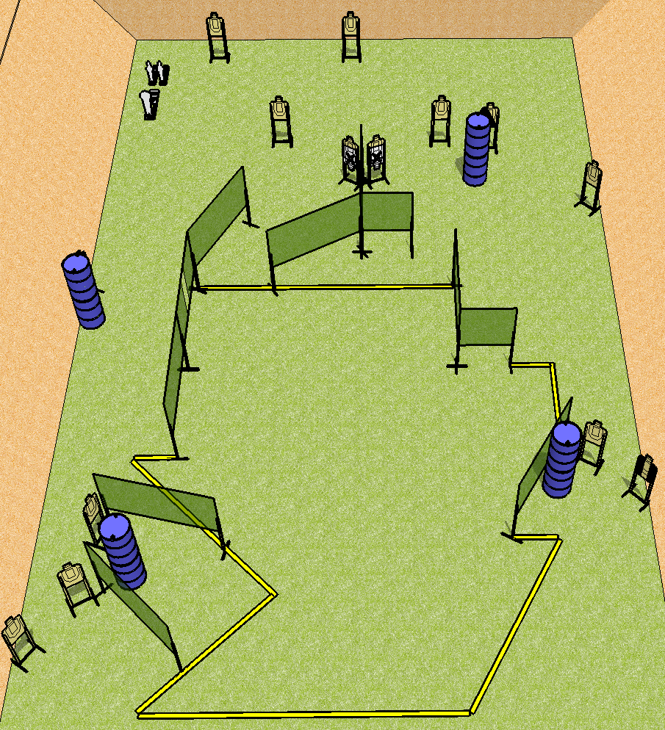
 | Dothan Practical Shooters – USPSA Match Backpedal Course Designer : Drew Coleman Bay: B4
Round Count 31 rounds 14 USPSA 1 colt peopper 2 mini poppers
Equipment List 19 wall feet 2 tux, 1 left diag 13 targets (11 + 2NS)

Slide 12
Backpedal
Written Stage Briefing
Scoring: Comstock Rounds: 31
Targets: 14 USPSA, 3 steel
Handgun start position: toes touching the downrange fault line, wrists below belt. Handgun is loaded and holstered.
PCC start position: toes touching the downrange fault line, stock on belt. Loaded carbine is held with both hands, safety on.
Stage Procedure: on the audible start signal, engage targets as they become available from within the shooting area.

